Slide 1
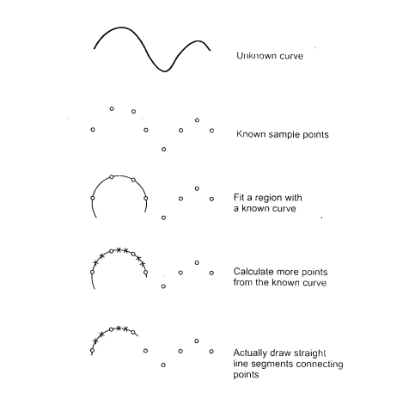

Slide 2
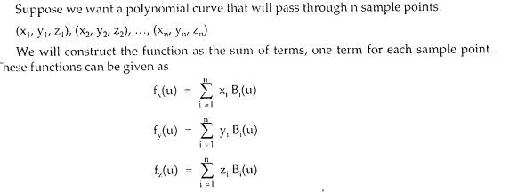
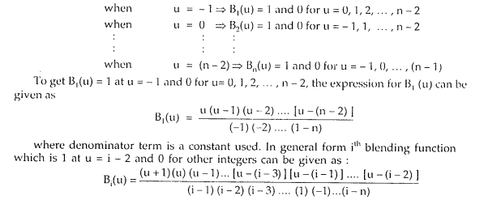

Slide 3
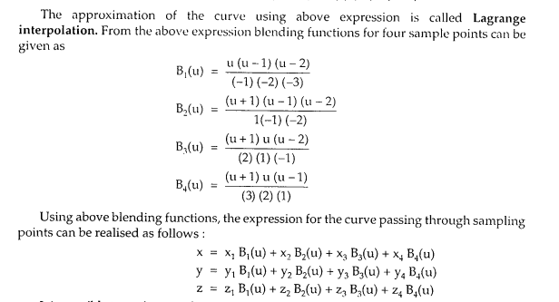

Slide 4
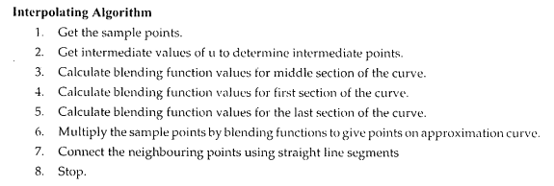

Slide 5
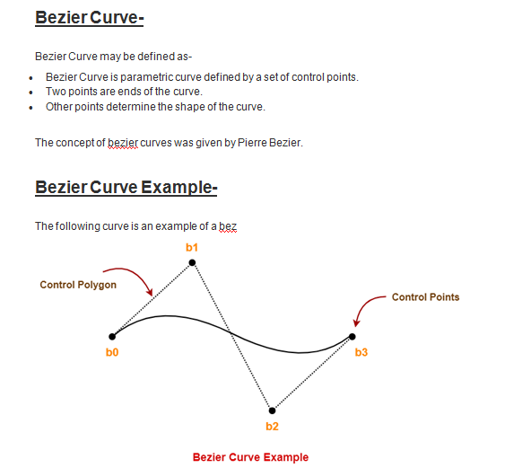
Here,
This bezier curve is defined by a set of control points b₀, b₁, b₂ and b₃.
Points b₀ and b₃ are ends of the curve.
Points b₁ and b₂ determine the shape of the curve.

Slide 6
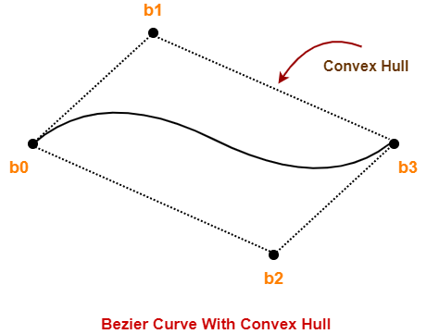
Bezier Curve Properties-
Few important properties of a bezier curve are-
Property-01:
Bezier curve is always contained within a polygon called as convex hull of its control points.

Slide 7
Property-02:
Bezier curve generally follows the shape of its defining polygon.
The first and last points of the curve are coincident with the first and last points of the defining polygon.
Property-03:
The degree of the polynomial defining the curve segment is one less than the total number of control points.
Degree = Number of Control Points – 1
Property-04:
The order of the polynomial defining the curve segment is equal to the total number of control points.
Property-05:
Bezier curve exhibits the variation diminishing property.
It means the curve do not oscillate about any straight line more often than the defining polygon.

Slide 8
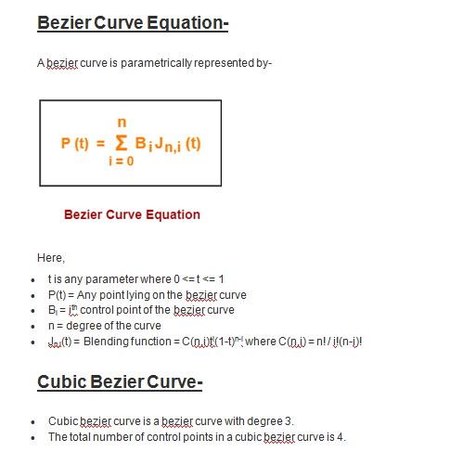

Slide 9
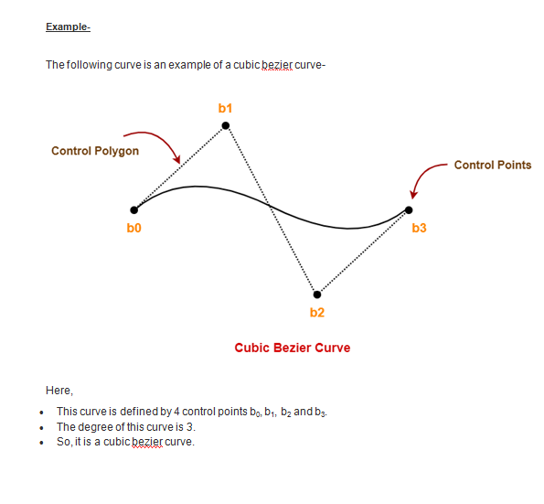

Slide 10
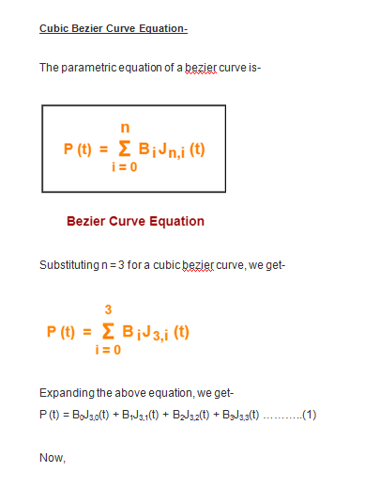

Slide 11
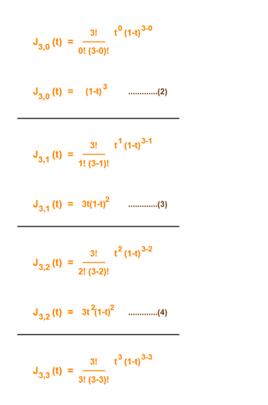

Slide 12
Using (2), (3), (4) and (5) in (1), we get-
P(t) = B₀(1-t)³ + B₁3t(1-t)² + B₂3t²(1-t) + B₃t³
This is the required parametric equation for a cubic bezier curve.

Slide 13
Problem-01: Given a bezier curve with 4 control points- B₀[1 0] , B₁[3 3] , B₂[6 3] , B₃[8 1] Determine any 5 points lying on the curve. Also, draw a rough sketch of the curve.
Solution-
We have-
The given curve is defined by 4 control points.
So, the given curve is a cubic bezier curve.
The parametric equation for a cubic bezier curve is-
P(t) = B₀(1-t)³ + B₁3t(1-t)² + B₂3t²(1-t) + B₃t³
Substituting the control points B₀, B₁, B₂ and B₃, we get-
P(t) = [1 0](1-t)³ + [3 3]3t(1-t)² + [6 3]3t²(1-t) + [8 1]t³ ……..(1)

Slide 14
Now,
To get 5 points lying on the curve, assume any 5 values of t lying in the range 0 <= t <= 1.
Let 5 values of t are 0, 0.2, 0.5, 0.7, 1

Slide 15
For t = 0:
Substituting t=0 in (1), we get-
P(0) = [1 0](1-0)³ + [3 3]3(0)(1-t)² + [6 3]3(0)²(1-0) + [8 1](0)³
P(0) = [1 0] + 0 + 0 + 0
P(0) = [1 0]
For t = 0.2:
Substituting t=0.2 in (1), we get-
P(0.2) = [1 0](1-0.2)³ + [3 3]3(0.2)(1-0.2)² + [6 3]3(0.2)²(1-0.2) + [8 1](0.2)³
P(0.2) = [1 0](0.8)³ + [3 3]3(0.2)(0.8)² + [6 3]3(0.2)²(0.8) + [8 1](0.2)³
P(0.2) = [1 0] x 0.512 + [3 3] x 3 x 0.2 x 0.64 + [6 3] x 3 x 0.04 x 0.8 + [8 1] x 0.008
P(0.2) = [1 0] x 0.512 + [3 3] x 0.384 + [6 3] x 0.096 + [8 1] x 0.008
P(0.2) = [0.512 0] + [1.152 1.152] + [0.576 0.288] + [0.064 0.008]
P(0.2) = [2.304 1.448]

Slide 16
For t = 0.5:
Substituting t=0.5 in (1), we get-
P(0.5) = [1 0](1-0.5)³ + [3 3]3(0.5)(1-0.5)² + [6 3]3(0.5)²(1-0.5) + [8 1](0.5)³
P(0.5) = [1 0](0.5)³ + [3 3]3(0.5)(0.5)² + [6 3]3(0.5)²(0.5) + [8 1](0.5)³
P(0.5) = [1 0] x 0.125 + [3 3] x 3 x 0.5 x 0.25 + [6 3] x 3 x 0.25 x 0.5 + [8 1] x 0.125
P(0.5) = [1 0] x 0.125 + [3 3] x 0.375 + [6 3] x 0.375 + [8 1] x 0.125
P(0.5) = [0.125 0] + [1.125 1.125] + [2.25 1.125] + [1 0.125]
P(0.5) = [4.5 2.375]

Slide 17
For t = 0.7:
Substituting t=0.7 in (1), we get-
P(t) = [1 0](1-t)³ + [3 3]3t(1-t)² + [6 3]3t²(1-t) + [8 1]t³
P(0.7) = [1 0](1-0.7)³ + [3 3]3(0.7)(1-0.7)² + [6 3]3(0.7)²(1-0.7) + [8 1](0.7)³
P(0.7) = [1 0](0.3)³ + [3 3]3(0.7)(0.3)² + [6 3]3(0.7)²(0.3) + [8 1](0.7)³
P(0.7) = [1 0] x 0.027 + [3 3] x 3 x 0.7 x 0.09 + [6 3] x 3 x 0.49 x 0.3 + [8 1] x 0.343
P(0.7) = [1 0] x 0.027 + [3 3] x 0.189 + [6 3] x 0.441 + [8 1] x 0.343
P(0.7) = [0.027 0] + [0.567 0.567] + [2.646 1.323] + [2.744 0.343]
P(0.7) = [5.984 2.233]

Slide 18
or t = 1:
Substituting t=1 in (1), we get-
P(1) = [1 0](1-1)³ + [3 3]3(1)(1-1)² + [6 3]3(1)²(1-1) + [8 1](1)³
P(1) = [1 0] x 0 + [3 3] x 3 x 1 x 0 + [6 3] x 3 x 1 x 0 + [8 1] x 1
P(1) = 0 + 0 + 0 + [8 1]
P(1) = [8 1]

Slide 19
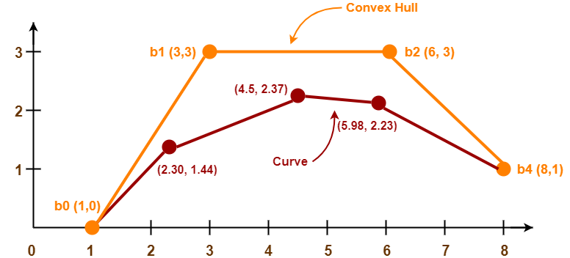
Following is the required rough sketch of the curve-

Slide 20
Problem -02 Obtain the curve parameters for drawing a smooth Bezier curve for the following control points A(0,0) B(10,30) C(60,20) D(70,-20)

Slide 21
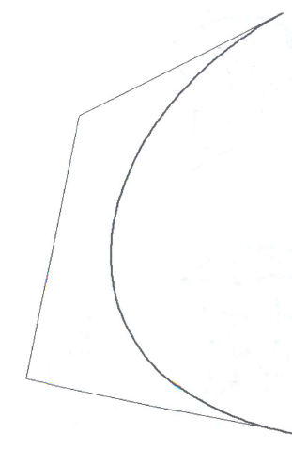
The cubic Bezier spline

Slide 22
The cubic Bezier spline

Slide 23
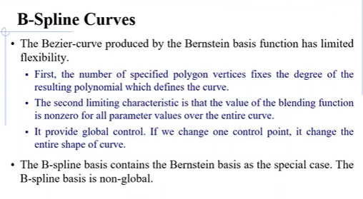

Slide 24
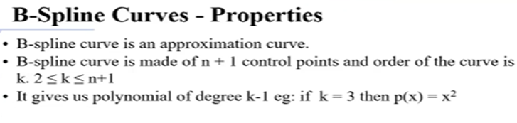
B-Spline Curves

Slide 25
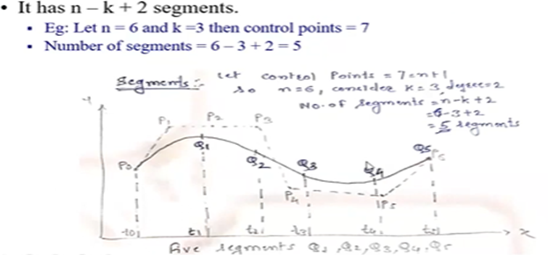

Slide 26
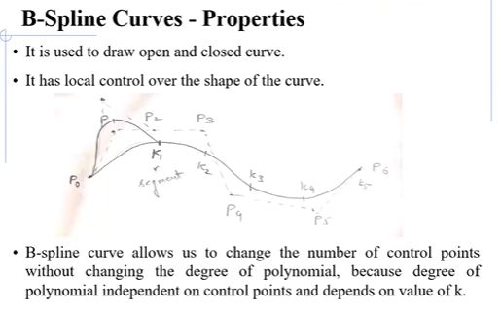

Slide 27
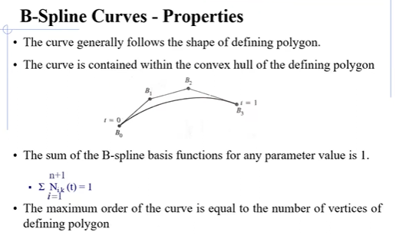

Slide 28
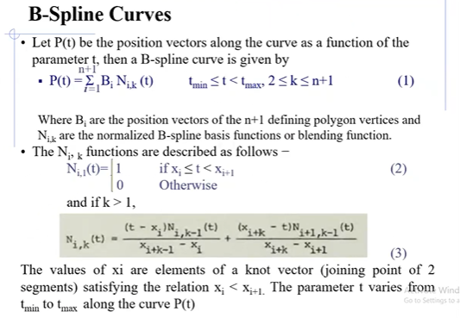

Slide 29
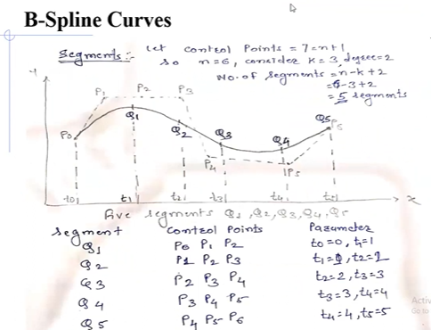

Slide 30
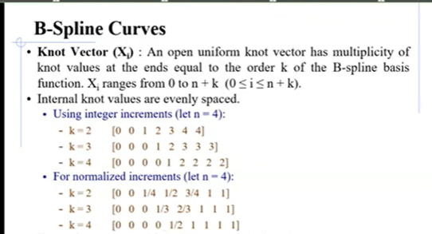

Slide 31


Slide 32
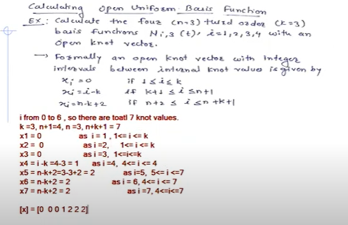

Slide 33
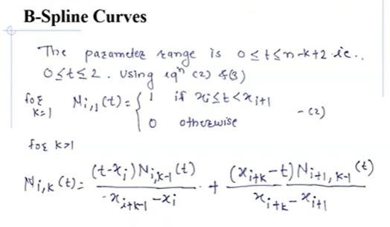

Slide 34
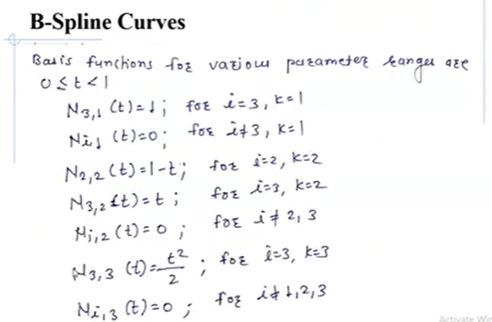

Slide 35
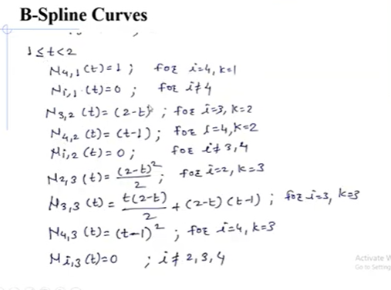

Slide 36
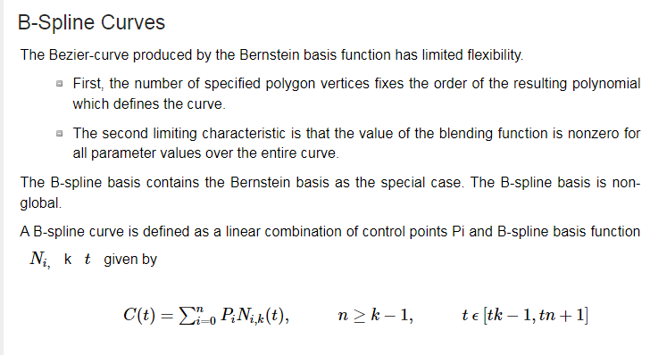

Slide 37
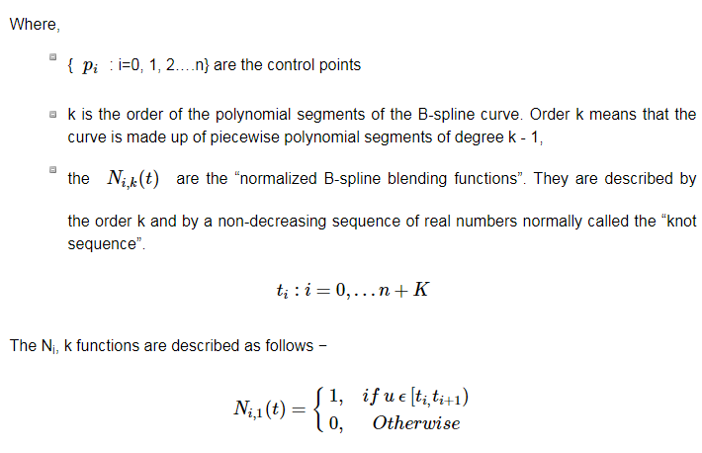

Slide 38
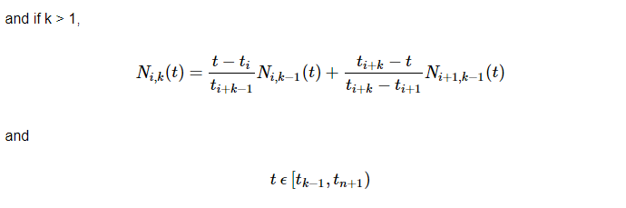

Slide 39
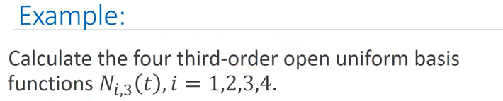
Here K=3

Slide 40
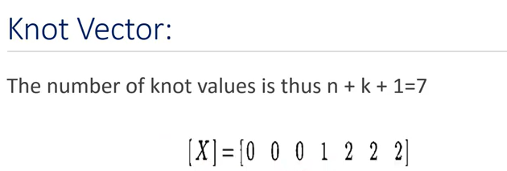

Slide 41
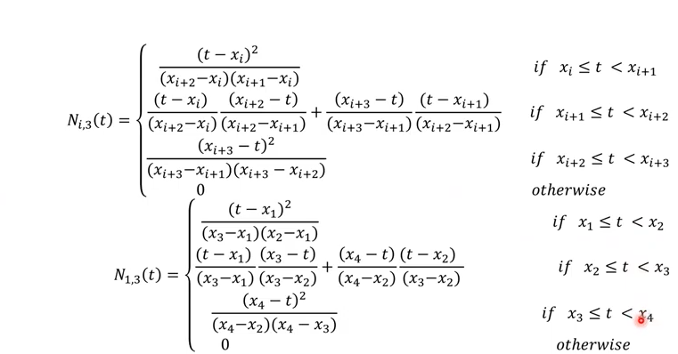

Slide 42
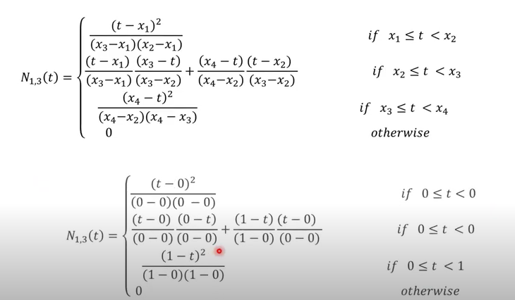

Slide 43
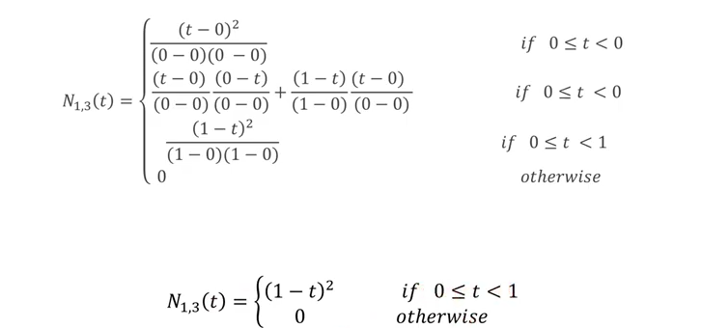

Slide 44
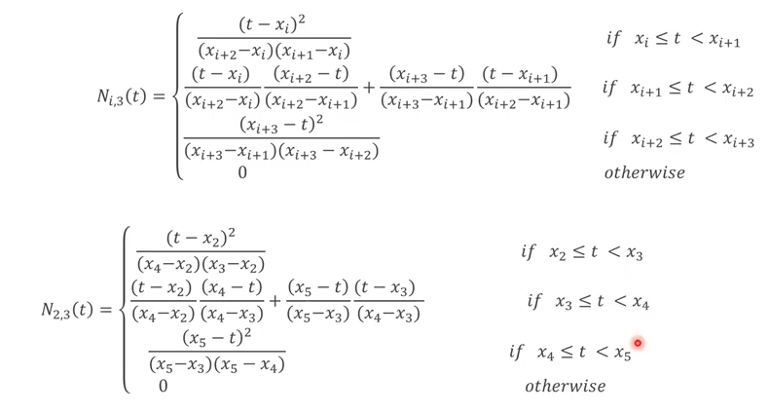

Slide 45
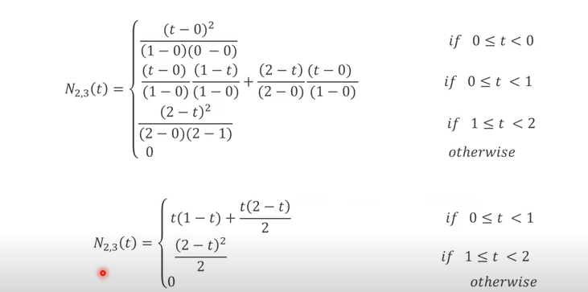

Slide 46
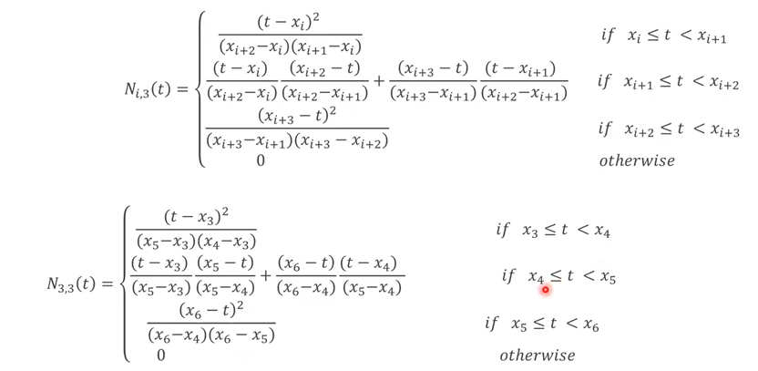

Slide 47
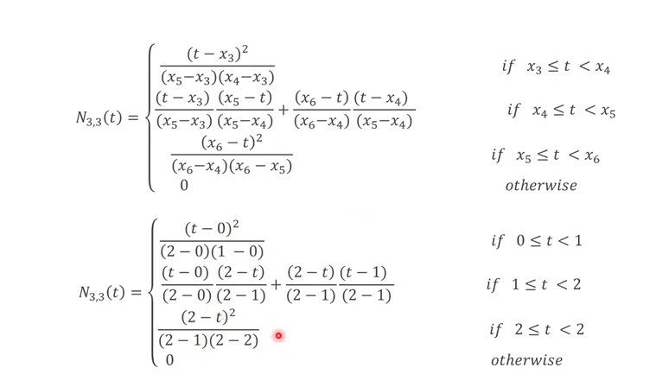

Slide 48
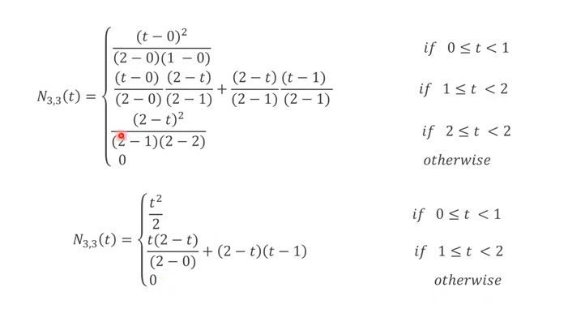

Slide 49
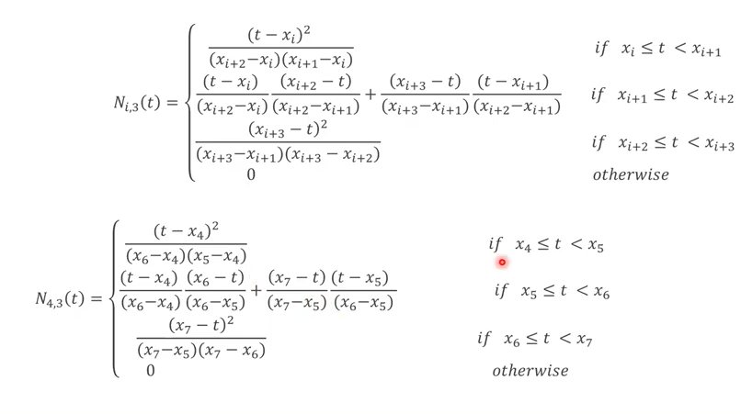

Slide 50
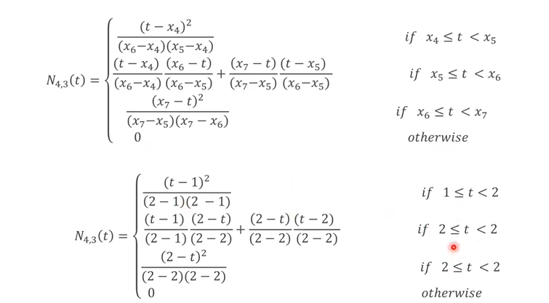

Slide 51
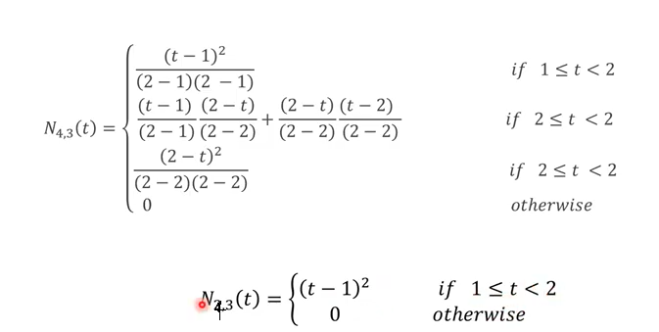

Slide 52
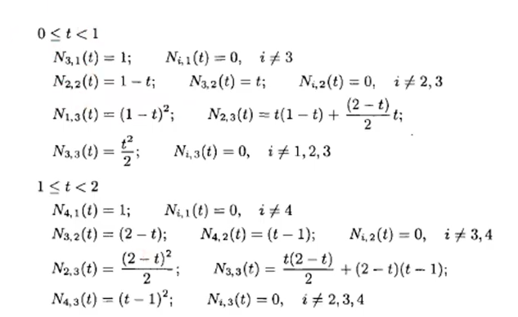

Slide 53
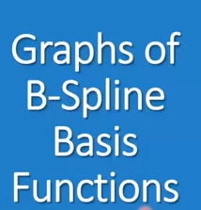
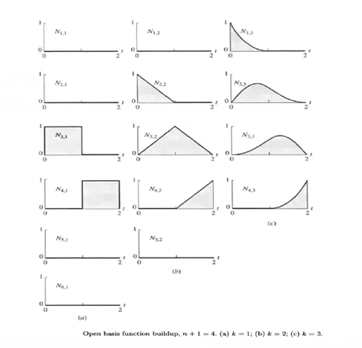

Slide 56
